Slide 2
What are Microservices?
Microservices is a service-oriented architecture pattern wherein applications are built as a collection of various smallest independent service units.
The term "micro" refers to the sizing of a microservice which must be manageable by a single development team ( 5 to 10 developers).
In this methodology, big applications are divided into smallest independent units.

Slide 3
What is Monolithic Architecture?
In Monolithic architecture is a big container in which all the software components of an application are clubbed into a single package.

Slide 4
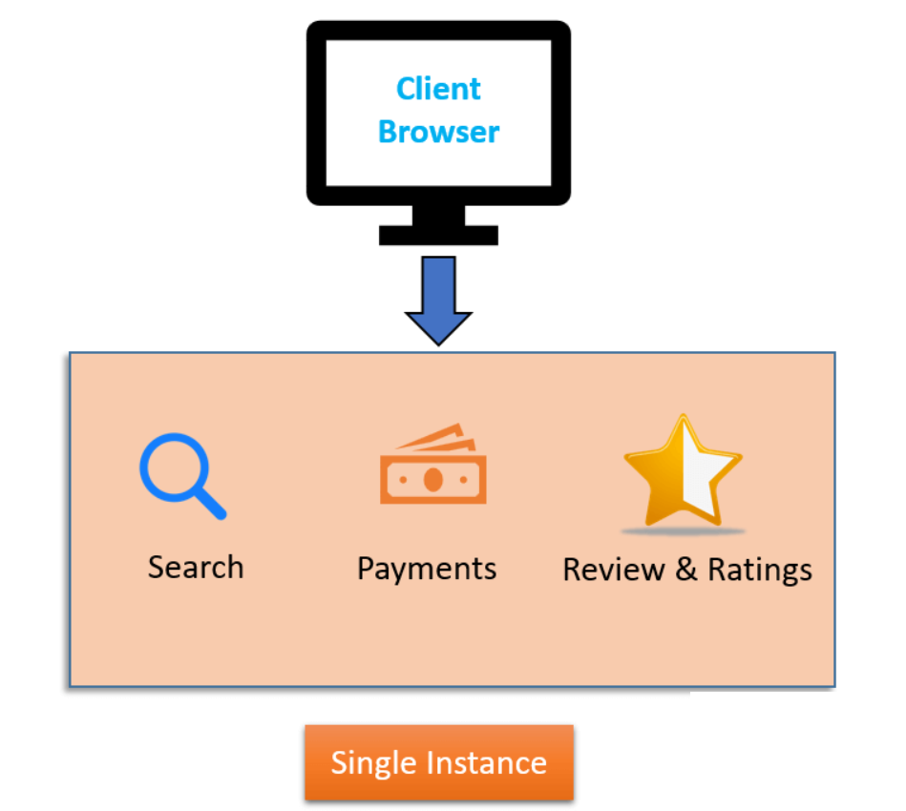

Slide 5
In any e-commerce application, there are some standard features like Search, Review & Ratings, and Payments.
These features are accessible to customers using their browser or apps. When the developer of the eCommerce site deploys the application, it is a single Monolithic unit.
The code for different features like Search, Review & Ratings, and Payments are on the same server.
To scale the application, you need to run multiple instances(servers) of these applications.

Slide 6
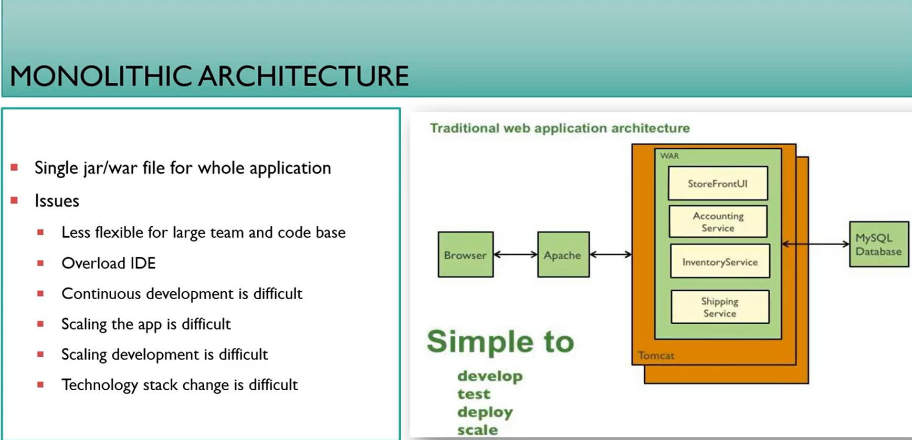

Slide 7
What is Microservice Architecture?
Microservice Architecture is an architectural development style that allows building applications as a collection of small autonomous services developed for a business domain.
It is a variant of structural style architecture that helps arrange applications as a loosely coupled service collection. The Microservice Architecture contains fine-grained services and lightweight protocols.
Let's take an example of e-commerce application developed with microservice architecture.
In Microservices architecture, each microservice is focused on single business capability. Search, Rating & Review and Payment each have their instance (server) and communicate with each other.

Slide 8
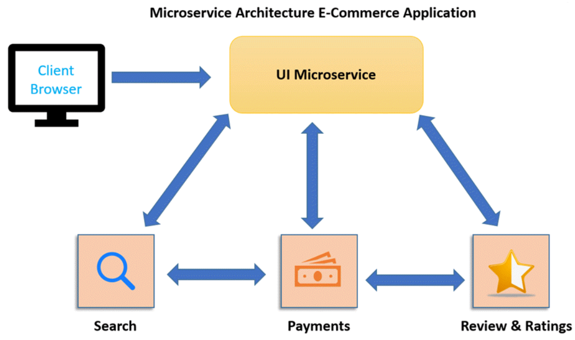

Slide 9
In Monolithic Architecture, all the components coalesce into a single module. But, in Microservices Architecture they are spread into individual modules(microservice) which communicate with each other as shown in the Microservices example above.
The communication between microservices is a stateless communication where each pair of request and response is independent. Hence, Microservices can communicate effortlessly. In the Microservice Architecture, the Data is federated. Each Microservice has its separate data store.

Slide 10
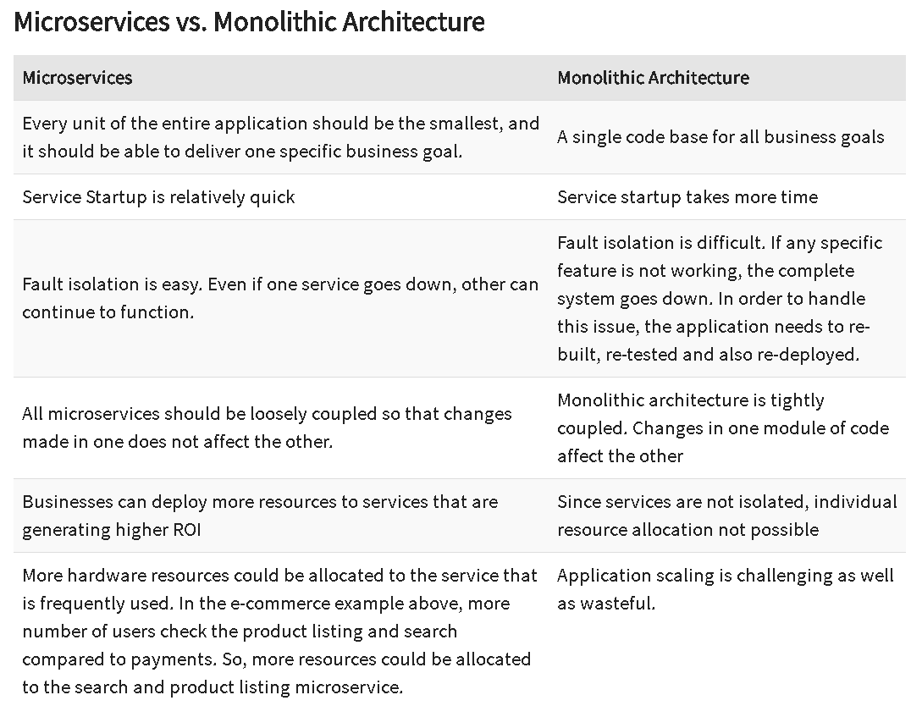

Slide 11
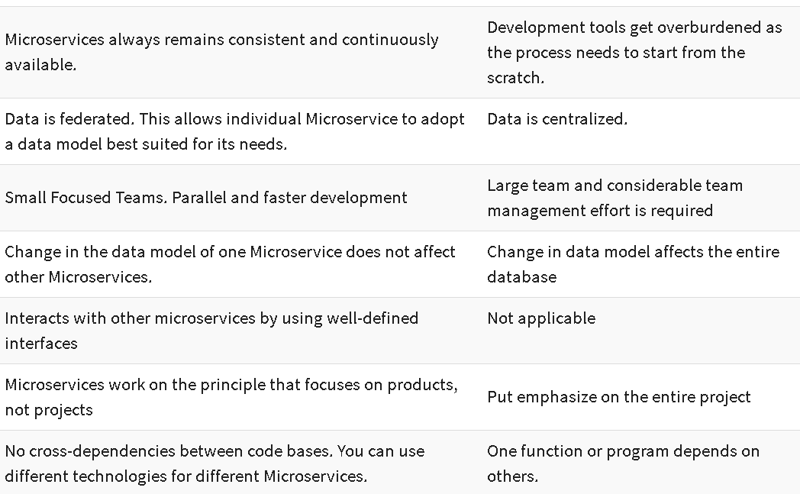

Slide 12
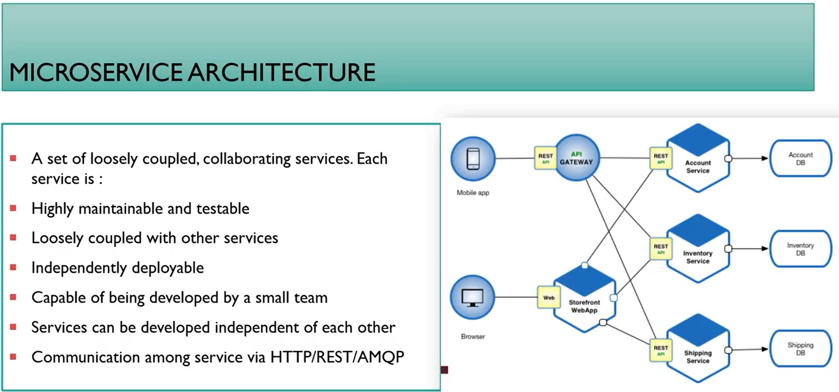

Slide 13
What is SOA?
SOA is an architectural pattern in computer software design. In this type of application, components provide services to other components via a communications protocol, typically over a network. The principles of service-orientation are independent of any product, vendor, or technology. The full form of SOA is service-oriented architecture
SOA makes it easier for software components over various networks to work with each other.Web services that are built as per the SOA architecture tend to make web services more independent.
What is SOA Architecture?
Service-oriented architecture is a style of software design. An architecture is categorized into two parts
functional aspects and
quality of service aspects.

Slide 14
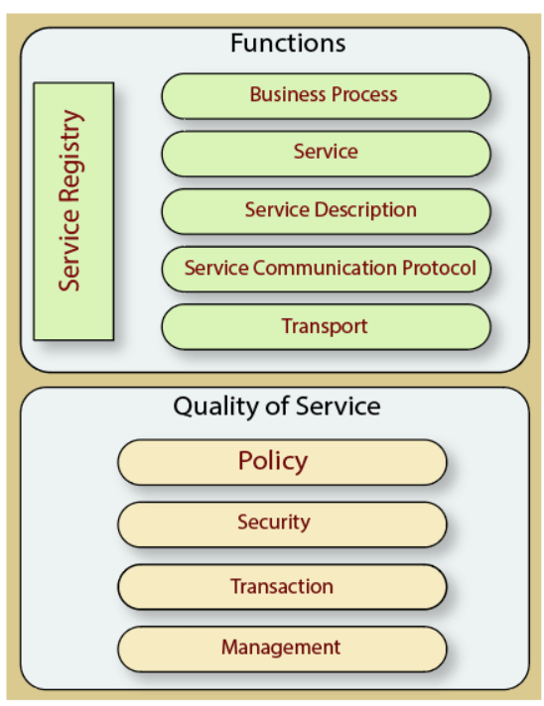

Slide 15
Functional Aspects:
Transport: This component transports the service requests from the service consumer to the service provider and service responses from them to the service consumer.
Service Communication Protocol: It allows the service provider and consumer to communicate with each other.
Service Description: It explains the service and data required to invoke it.
Service: It is an actual service.
Business Process: This component represents the group of services called in a certain predefined sequence associated with the specific rules to meet the business demands.
Service Registry: This registry contains the description of data that is used by service providers to publish their services.
Quality of Service Aspects:
Policy: It is a set of protocols according to which service providers create and provide services to consumers.
Security: It represents the set of protocols needed for the identification and authorization process.
Transaction: It provides the surety of consistent results.
Management: This component of SOA helps you define the set of attributes which are used to manage the services.

Slide 16
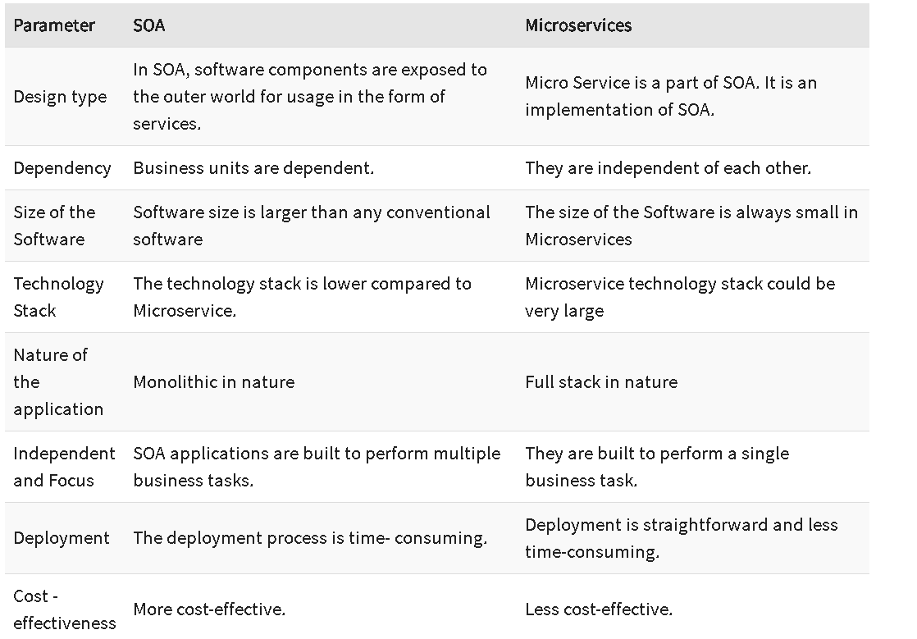

Slide 17
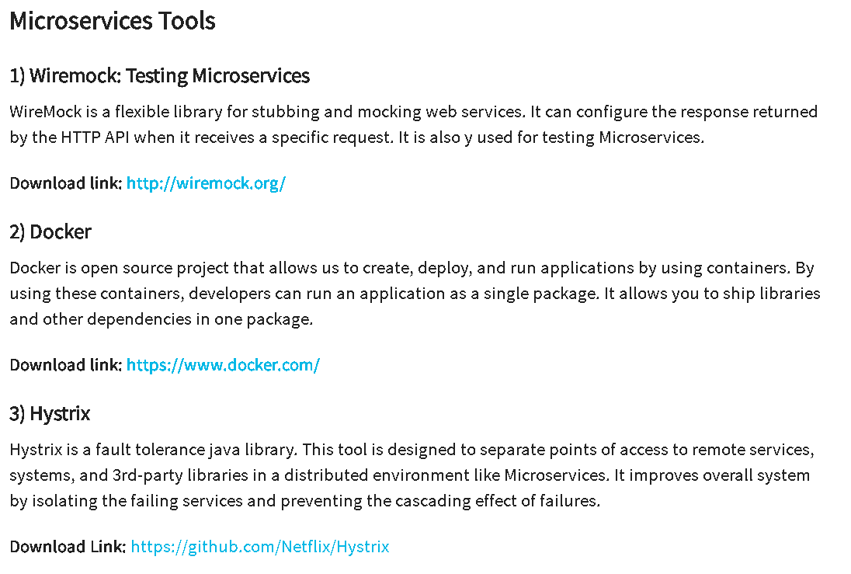

Slide 18
1. What are Microservices?
Microservices is an architectural style where an application is structured as a collection of small, independent services.
Each service:
Focuses on a specific business capability (e.g., User Service, Order Service, Payment Service).
Runs in its own process.
Communicates with others via lightweight protocols (HTTP/REST, gRPC, or messaging queues).
Can be developed, deployed, and scaled independently.

Slide 19
2. Why Microservices?
Scalability → Scale only the service you need (e.g., scale payment service if demand is high).
Flexibility in technology → One service in Java (Spring Boot), another in Node.js, etc.
Faster development → Small teams can work independently.
Resilience → If one service fails, the whole system doesn’t crash.

Slide 20
3. Spring Boot & Microservices
Spring Boot makes it easy to build microservices because it provides:
Embedded servers (Tomcat/Jetty) → Run independently, no need for external app server.
Spring Cloud integration for:
Service Discovery (Eureka)
API Gateway (Spring Cloud Gateway)
Centralized Configuration (Spring Cloud Config)
Resilience (Circuit Breakers with Resilience4j)

Slide 21
4. Typical Microservices Architecture
API Gateway → Single entry point for clients.
Service Registry (Eureka) → Keeps track of services.
Config Server → Centralized properties management.
Individual Microservices (e.g., User Service, Order Service).
Database per service (ensures loose coupling).
Message Broker (Kafka/RabbitMQ) for async communication.

Slide 22
What is Load Balancing?
Load balancing is the process of distributing incoming traffic across multiple servers (or instances) so that no single server is overwhelmed. It improves performance, reliability, and user experience in cloud-hosted applications.
Why Use Load Balancing in Cloud?
=>Scalability – handle large amounts of traffic by scaling horizontally (adding more servers).
=>Fault Tolerance – if one server fails, traffic is redirected to healthy servers.
=>High Availability – ensures applications are always accessible.
=>Optimized Performance – balances requests to avoid bottlenecks.
=>Flexibility – supports multi-region deployments.

Slide 24
What is OAuth 2?
OAuth 2.0 is an authorization framework that lets applications access resources (APIs) on behalf of a user, without sharing their credentials (like username & password).
Instead of passing credentials, the client app gets an access token from the Authorization Server and uses that token to call the Resource Server (API).
OAuth 2 Components in Spring Boot
Authorization Server – Issues tokens (e.g., Keycloak, Okta, Auth0, Spring Authorization Server).
Resource Server – The API that protects resources using OAuth 2 tokens.
Client – App (Angular/React, Postman, mobile app) requesting access.

Slide 25
OAuth 2 Flow (Authorization Code Grant Example)
================================================
User tries to access a client app.
Client redirects user to Authorization Server (e.g., Google/Okta).
User logs in → Authorization Server issues authorization code.
Client exchanges code for access token.
Client calls Resource Server API using Authorization: Bearer <token>.
https://www.youtube.com/watch?v=xAaGxhDiGg8

